Slide 1
A Rest From REST: GraphQL!
May 7th, 2020

Slide 2

Who am I? - Shreyas Devalapurkar - Software Engineer @ NTTDS

Slide 3
What is REST?
Representational State Transfer Protocol.
Client — the client is the person or software who uses the API.
Resource — a resource can be any object the API can provide information about.
When a RESTful API is called, the server will transfer to the client a representation of the state of the requested resource.

Slide 4
Why Take a Rest from REST?
Too inflexible to keep up with the rapidly changing requirements of the clients that access them.
A better option exists.

Slide 5
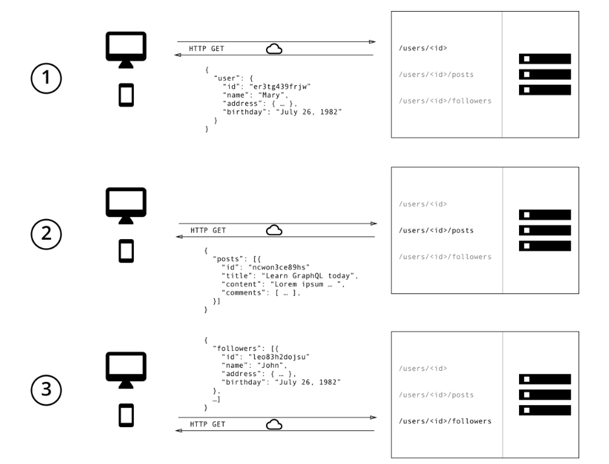
Our Internal Photo App API: NTTGram

Slide 6
GraphQL to the Rescue!
A query language for your API.
Ask for what you need, get that. Exactly that.
Get many resources. One request.

Slide 7
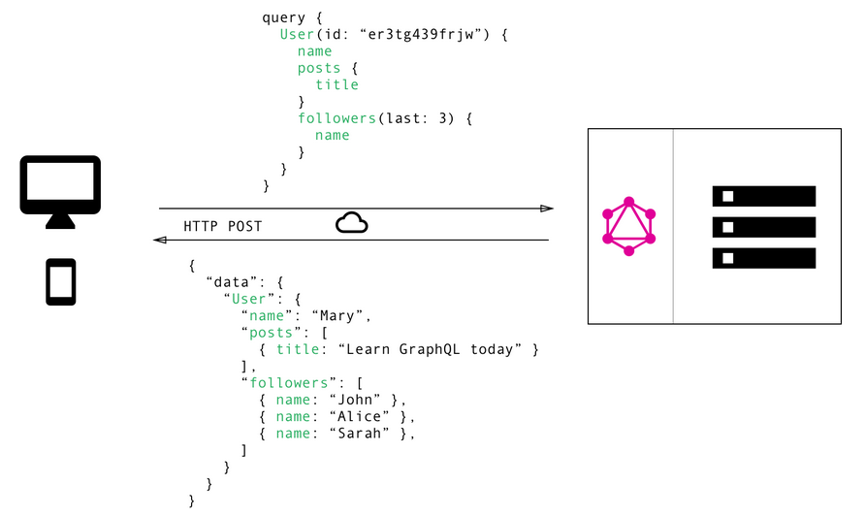
Our Internal Photo App API: NTTGram

Slide 8
What Does it Provide?
A data description language -> Schema.
A query resolution mechanism -> Resolvers.
A query language and data format -> Queries.

Slide 9
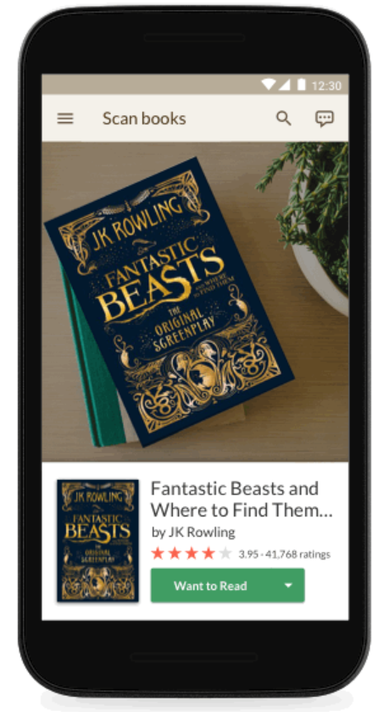
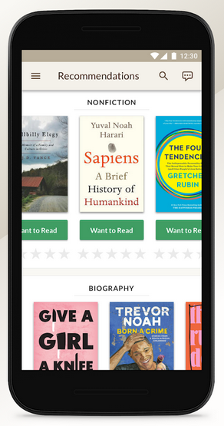
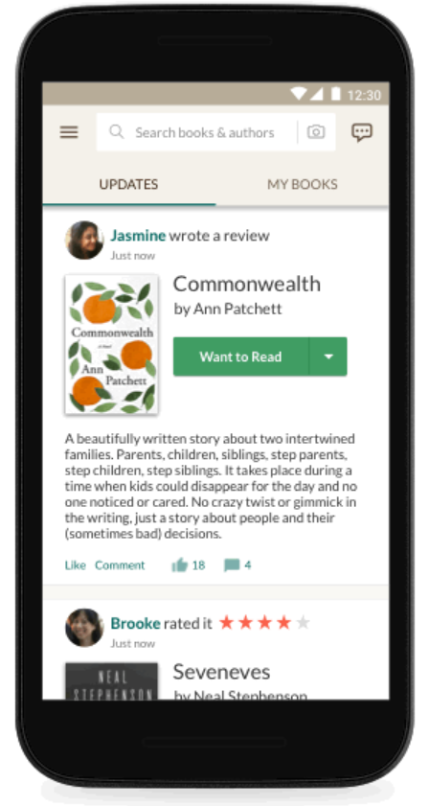
Let’s Build Goodreads

Slide 10
Deeper Dive/Demo!
We need a schema to describe the data we need to provide.
Note: We are modelling how data is related together, not implementing how data is related together.
For every type and for every field on that type, GraphQL is going to execute a resolver for that field.
Queries! Time to get the data from our API.

Slide 11
Advantages of GraphQL
Clients can dictate exactly what they need from the server and receive that data in a predictable way.
No more overfetching of data. AKA: Downloading superfluous data.
No more underfetching of data. AKA: The n+1 problem.
Strongly typed, allowing consumers to know what form data exists in.
Rapid product iterations on frontend.

Slide 12
It Can Never Be Perfect
If you love HTTP status codes, you’re going to be disappointed.
Complexity.
Error handling is a bit more difficult.
There are REST alternatives.

Slide 13
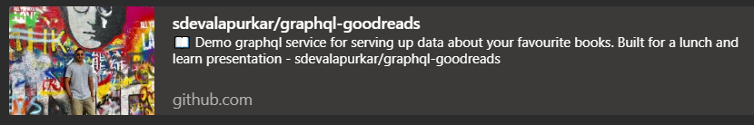
For Reference
https://github.com/sdevalapurkar/graphql-goodreads

Slide 14
Acknowledgements
I would sincerely like to thank:
Alex Joyeux
James Jose

Slide 15
Thank you!! and Questions??
Hope that was enjoyable! Thank you all.
Have a great rest of your day.

